Slide 1
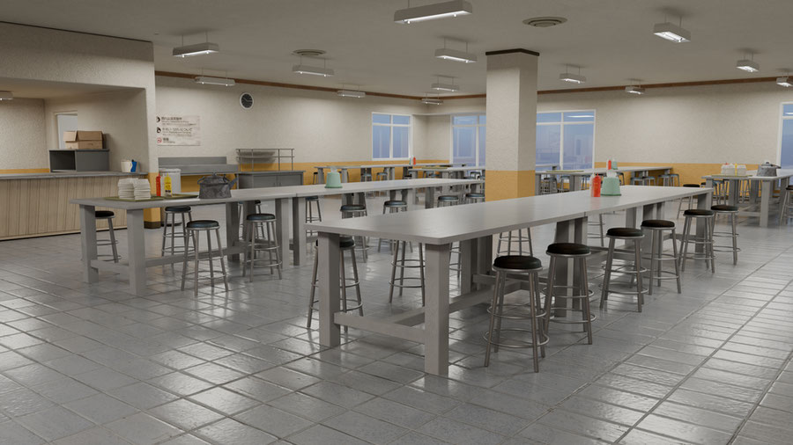
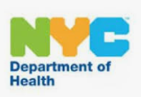
Department of Health and Mental Hygiene (DOHMH) School Cafeteria Inspections

Slide 2
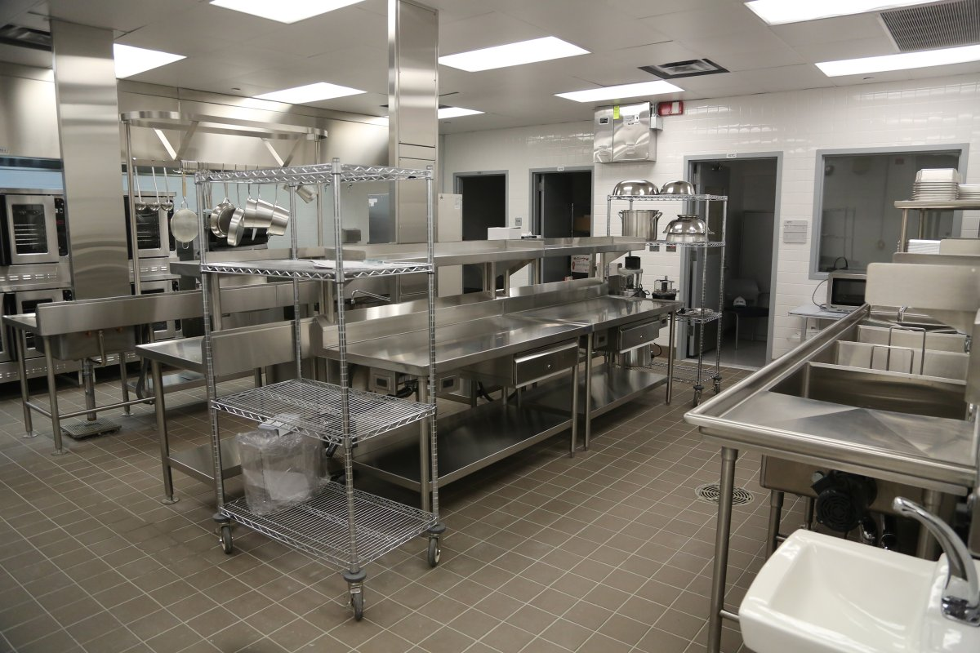
Introduction
The goal of the DOHMH school cafeteria inspections is to ensure that all food served to students are in compliance with NYS and NYC Food Safety Regulations.
NYC laws requires a minimum of 2 inspections in a school building, each school year. Inspections are unannounced, therefore, the Department of Education, including the kitchen staff, will not know when the cafeteria will be inspected.
Research Questions:
What is the distribution of violation levels across the five boroughs?
How do violation levels differ between private and public schools?

Slide 3

Data Sources:
Dataset Name: DOHMH School Cafeteria Inspections (2016-2019): https://data.cityofnewyork.us/Health/DOHMH-School-Cafeteria-inspections
Agency: DOHMH
Rows: 24.6K Rows
Columns: 22 Columns
Creation Date: July 7, 2020
Last Updated: October 5, 2023
Dataset Name: DOHMH School Cafeteria Inspections (2020-Present): https://data.cityofnewyork.us/Health/DOHMH-School-Cafeteria-Inspections-2020-Present-/5ery-qagt/about_data
Agency: DOHMH
Rows: 15.5K
Columns: 25
Creation Date: March 23, 2023
Last Updated: June 1, 2024

Slide 4

Methodologies
Tools Used:
Juypter Notebooks, Pandas, Matplotlib, Seaborn
Data Preparation:
Two different files were utilized for the dataset and both were downloaded to the same format (.csv)
The files were imported into Jupyter Notebooks and merged into a single data frame and using the pd.concat function.
Data Cleaning and analyses:
After merging the data, I noticed that some columns were duplicated rather than stacked due to mismatched column names between the two datasets.
Identified and corrected the differences in column names, case sensitivity considered
Removed unnecessary columns and ensured both datasets had the same number of columns before merging again
Renamed abbreviated and null values, removed duplicate rows
Used aggregate functions such as groupby to group and analyze the data
This Photo by Unknown Author is licensed under CC BY

Slide 5
Violation Levels
There are five different levels of violations, with critical violation being most likely to contribute to food borne illnesses.
Administrative Violation
Current valid permit, registration or other authorization to operate establishment not available.
Critical Violation
Food contact surface not properly washed, rinsed and sanitized after each use and following any activity when contamination may have occurred.
General Violation
Food contact surface not properly maintained.
Nutritional Violation
Additional nutritional information statement not posted, or additional nutritional information not provided
Tobacco Violation
Tobacco use observed in facility's food and/or non-food areas
Food allergy information poster not conspicuously posted where food is being prepared or processed by food workers.
Evidence of Live roaches, mice, or rats present in facility's food and/or non-food areas
Accurate thermometer not provided or properly located in refrigerated, cold storage or hot holding equipment
Noncompliance with nutritional standards

Slide 6
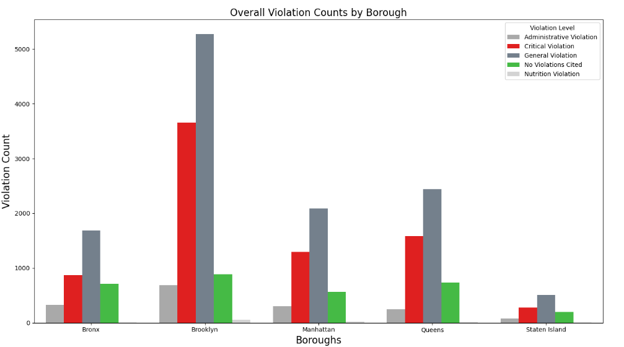
Violations Levels by the Boroughs
Brooklyn exhibits the highest number of critical violations indicating a significant food safety issue in the Borough. This high count suggests a need for increased inspections and improved compliance with health regulations.
The data reveals a worrying trend, the number of both general and critical violations cited in each borough is consistently higher than the instances of no violations cited.
Boroughs | Administrative Violation | Critical Violation | General Violation | No Violations Cited | Nutrition Violation
Bronx | 330 | 867 | 1687 | 714 | 7
Brooklyn | 684 | 3658 | 5273 | 883 | 56
Manhattan | 305 | 1297 | 2086 | 565 | 24
Queens | 243 | 1580 | 2437 | 735 | 12
Staten Island | 81 | 281 | 507 | 194 | 8
6

Slide 7
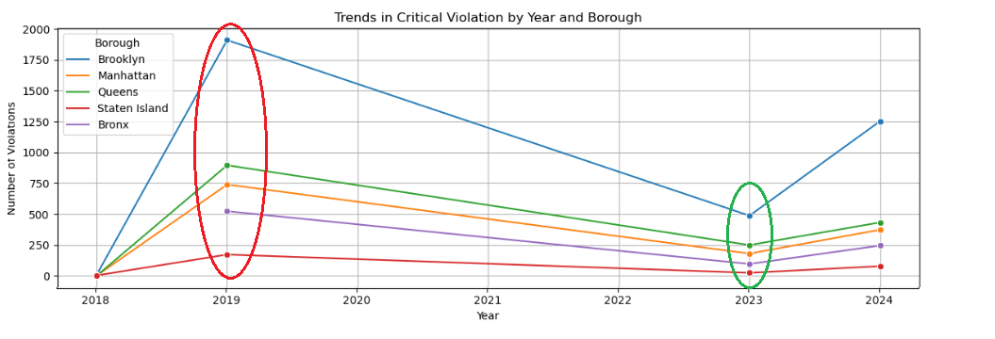
Critical Violation Trends by Year and Borough
This graph analyzes critical violation trends across the five boroughs from 2018-2024, highlighting a significant spike in 2019 and a notable decline in 2023.
Despite improvements in most areas, Brooklyn consistently shows higher violation numbers, indicating a need for targeted invention.

Slide 8
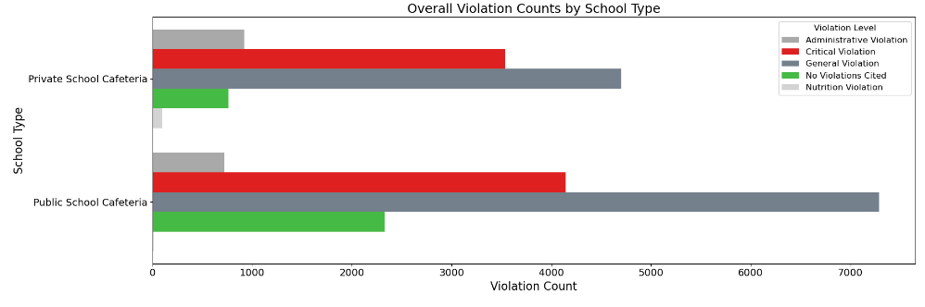
Violation Levels by School Type
This chart displays the overall violation counts by school type, comparing private and public school cafeterias across different violation levels, with public schools having higher overall counts.
Notably, the higher tuition fees associated with private schools do not correlate with better cafeteria quality as both types of schools exhibits substantial administrative and critical violations.

Slide 9
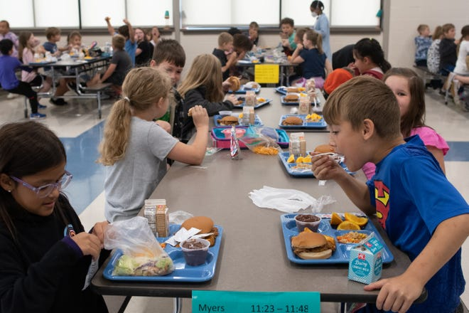
Conclusion
In conclusion, Brooklyn has the highest number of critical food safety violations.
While critical violations spiked in 2019 and declined in 2023, it is still concerning that the number of critical and general violations cited are significantly higher than instances of no violations cited.
This indicates a need for increased inspections and compliance efforts across the board
It is interesting to note that the higher tuition fees associated with private schools do not correlate with better cafeteria quality as both types of schools exhibits substantial administrative and critical violations.

Slide 10
Thank you!

